Slide 1
XML for Beginners Ralf Schenkel
1. XML – the Snake Oil of the Internet age?
2. Basic XML Concepts
3. Defining XML Data Formats
4. Querying XML Data

Slide 2
XML is not…
A replacement for HTML (but HTML can be generated from XML)
A presentation format (but XML can be converted into one)
A programming language (but it can be used with almost any language)
A network transfer protocol (but XML may be transferred over a network)
A database (but XML may be stored into a database)

Slide 3
But then – what is it?
XML is a meta markup language for text documents / textual data
XML allows to define languages („applications“) to represent text documents / textual data

Slide 4
XML by Example
<article>
<author>Gerhard Weikum</author>
<title>The Web in 10 Years</title>
</article>
Easy to understand for human users
Very expressive (semantics along with the data)
Well structured, easy to read and write from programs
This looks nice, but…

Slide 5
XML by Example
… this is XML, too:
<t108>
<x87>Gerhard Weikum</x87>
<g10>The Web in 10 Years</g10>
</t108>
Hard to understand for human users
Not expressive (no semantics along with the data)
Well structured, easy to read and write from programs

Slide 6
XML by Example
… and what about this XML document:
<data>
ch37fhgks73j5mv9d63h5mgfkds8d984lgnsmcns983
</data>
Impossible to understand for human users
Not expressive (no semantics along with the data)
Unstructured, read and write only with special programs
The actual benefit of using XML highly depends on the design of the application.

Slide 7
Possible Advantages of Using XML
Truly Portable Data
Easily readable by human users
Very expressive (semantics near data)
Very flexible and customizable (no finite tag set)
Easy to use from programs (libs available)
Easy to convert into other representations (XML transformation languages)
Many additional standards and tools
Widely used and supported

Slide 8



App. Scenario 1: Content Mgt.
Clients
XML2HTML
XML2WML
XML2PDF
Converters
Database with XML documents

Slide 9
App. Scenario 2: Data Exchange
Buyer
Supplier
XML Adapter
XML
XML Adapter
(BMECat, ebXML, RosettaNet, BizTalk, …)
Legacy System (e.g., SAP R/2)
Legacy System (e.g., Cobol)
Order

Slide 10
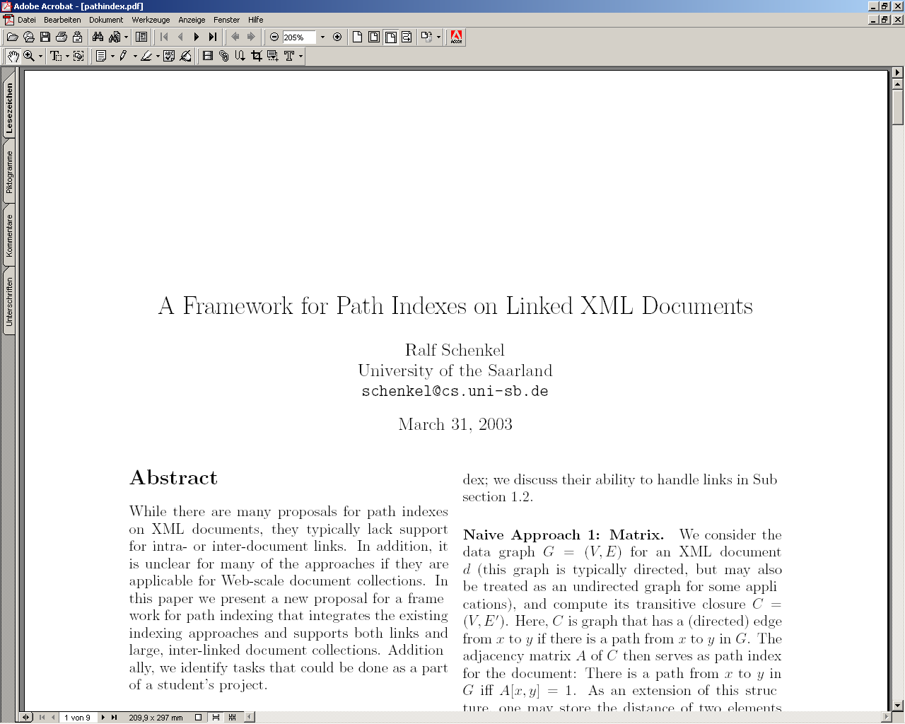
App. Scenario 3: XML for Metadata
<rdf:RDF
<rdf:Description rdf:about="http://www-dbs/Sch03.pdf">
<dc:title>A Framework for…</dc:title>
<dc:creator>Ralf Schenkel</dc:creator>
<dc:description>While there are...</dc:description>
<dc:publisher>Saarland University</dc:publisher>
<dc:subject>XML Indexing</dc:subject>
<dc:rights>Copyright ...</dc:rights>
<dc:type>Electronic Document</dc:type>
<dc:format>text/pdf</dc:format>
<dc:language>en</dc:language>
</rdf:Description>
</rdf:RDF>

Slide 11
App. Scenario 4: Document Markup
<article>
<section id=„1“ title=„Intro“>
This article is about <index>XML</index>.
</section>
<section id=„2“ title=„Main Results“>
<name>Weikum</name> <cite idref=„Weik01“/> shows the following theorem (see Section <ref idref=„1“/>)
<theorem id=„theo:1“ source=„Weik01“>
For any XML document x, ...
</theorem>
</section>
<literature>
<cite id=„Weik01“><author>Weikum</author></cite>
</literature>
</article>

Slide 12
App. Scenario 4: Document Markup
Document Markup adds structural and semantic information to documents, e.g.
Sections, Subsections, Theorems, …
Cross References
Literature Citations
Index Entries
Named Entities
This allows queries like
Which articles cite Weikum‘s XML paper from 2001?
Which articles talk about (the named entity) „Weikum“?

Slide 13
XML for Beginners Part 2 – Basic XML Concepts
2.1 XML Standards by the W3C
2.2 XML Documents
2.3 Namespaces

Slide 14
2.1 XML Standards – an Overview
XML Core Working Group:
XML 1.0 (Feb 1998), 1.1 (candidate for recommendation)
XML Namespaces (Jan 1999)
XML Inclusion (candidate for recommendation)
XSLT Working Group:
XSL Transformations 1.0 (Nov 1999), 2.0 planned
XPath 1.0 (Nov 1999), 2.0 planned
eXtensible Stylesheet Language XSL(-FO) 1.0 (Oct 2001)
XML Linking Working Group:
XLink 1.0 (Jun 2001)
XPointer 1.0 (March 2003, 3 substandards)
XQuery 1.0 (Nov 2002) plus many substandards
XMLSchema 1.0 (May 2001)
…

Slide 15
2.2 XML Documents
What‘s in an XML document?
Elements
Attributes
plus some other details (see the Lecture if you want to know this)

Slide 16
A Simple XML Document
<article>
<author>Gerhard Weikum</author>
<title>The Web in Ten Years</title>
<text>
<abstract>In order to evolve...</abstract>
<section number=“1” title=“Introduction”>
The <index>Web</index> provides the universal...
</section>
</text>
</article>

Slide 17
A Simple XML Document
<article>
<author>Gerhard Weikum</author>
<title>The Web in Ten Years</title>
<text>
<abstract>In order to evolve...</abstract>
<section number=“1” title=“Introduction”>
The <index>Web</index> provides the universal...
</section>
</text>
</article>
Freely definable tags

Slide 18
A Simple XML Document
Start Tag
<article>
<author>Gerhard Weikum</author>
<title>The Web in Ten Years</title>
<text>
<abstract>In order to evolve...</abstract>
<section number=“1” title=“Introduction”>
The <index>Web</index> provides the universal...
</section>
</text>
</article>
Content of the Element (Subelements and/or Text)
End Tag
Element

Slide 19
A Simple XML Document
<article>
<author>Gerhard Weikum</author>
<title>The Web in Ten Years</title>
<text>
<abstract>In order to evolve...</abstract>
<section number=“1” title=“Introduction”>
The <index>Web</index> provides the universal...
</section>
</text>
</article>
Attributes with name and value

Slide 20
Elements in XML Documents
(Freely definable) tags: article, title, author
with start tag: <article> etc.
and end tag: </article> etc.
Elements: <article> ... </article>
Elements have a name (article) and a content (...)
Elements may be nested.
Elements may be empty: <this_is_empty/>
Element content is typically parsed character data (PCDATA), i.e., strings with special characters, and/or nested elements (mixed content if both).
Each XML document has exactly one root element and forms a tree.
Elements with a common parent are ordered.

Slide 21
Elements vs. Attributes
Elements may have attributes (in the start tag) that have a name and
a value, e.g. <section number=“1“>.
What is the difference between elements and attributes?
Only one attribute with a given name per element (but an arbitrary number of subelements)
Attributes have no structure, simply strings (while elements can have subelements)
As a rule of thumb:
Content into elements
Metadata into attributes
Example:
<person born=“1912-06-23“ died=“1954-06-07“>
Alan Turing</person> proved that…

Slide 22
XML Documents as Ordered Trees
article
author
title
text
number=“1“
abstract
section
Gerhard Weikum
title=“…“
In order …
The
index
provides …
The Web in 10 years
Web

Slide 23
More on XML Syntax
Some special characters must be escaped using entities: < → &lt; & → &amp; (will be converted back when reading the XML doc)
Some other characters may be escaped, too: > → &gt; “ → &quot; ‘ → &apos;

Slide 24
Well-Formed XML Documents
A well-formed document must adher to, among others, the following rules:
Every start tag has a matching end tag.
Elements may nest, but must not overlap.
There must be exactly one root element.
Attribute values must be quoted.
An element may not have two attributes with the same name.
Comments and processing instructions may not appear inside tags.
No unescaped < or & signs may occur inside character data.

Slide 25
Well-Formed XML Documents
A well-formed document must adher to, among others, the following rules:
Every start tag has a matching end tag.
Elements may nest, but must not overlap.
There must be exactly one root element.
Attribute values must be quoted.
An element may not have to attributes with the same name.
Comments and processing instructions may not appear inside tags.
No unescaped < or & signs may occur inside character data.
Only well-formed documents can be processed by XML parsers.

Slide 26
2.3 Namespaces
<library>
<description>Library of the CS Department</description>
<book bid=“HandMS2000“>
<title>Principles of Data Mining</title>
<description>
Short introduction to <em>data mining</em>, useful
for the IRDM course
</description>
</book>
</library>
Semantics of the description element is ambigous Content may be defined differently Renaming may be impossible (standards!)
⇒ Disambiguation of separate XML applications using unique prefixes

Slide 27
Namespace Syntax
<dbs:book xmlns:dbs=“http://www-dbs/dbs“>
Prefix as abbrevation of URI
Unique URI to identify the namespace
Signal that namespace definition happens

Slide 28
Namespace Example
<dbs:book xmlns:dbs=“http://www-dbs/dbs“>
<dbs:description> ... </dbs:description>
<dbs:text>
<dbs:formula>
<mathml:math xmlns:mathml=“http://www.w3.org/1998/Math/MathML“>
...
</mathml:math>
</dbs:formula>
</dbs:text>
</dbs:book>

Slide 29
Default Namespace
Default namespace may be set for an element and its content (but not its attributes):
<book xmlns=“http://www-dbs/dbs“>
<description>...</description>
<book>
Can be overridden in the elements by specifying the namespace there (using prefix or default namespace)

Slide 30
XML for Beginners Part 3 – Defining XML Data Formats
3.1 Document Type Definitions
3.2 XML Schema (very short)

Slide 31
3.1 Document Type Definitions
Sometimes XML is too flexible:
Most Programs can only process a subset of all possible XML applications
For exchanging data, the format (i.e., elements, attributes and their semantics) must be fixed
Document Type Definitions (DTD) for establishing the vocabulary for one XML application (in some sense comparable to schemas in databases)
A document is valid with respect to a DTD if it conforms to the rules specified in that DTD.
Most XML parsers can be configured to validate.

Slide 32
DTD Example: Elements
<!ELEMENT article (title,author+,text)>
<!ELEMENT title (#PCDATA)>
<!ELEMENT author (#PCDATA)>
<!ELEMENT text (abstract,section*,literature?)>
<!ELEMENT abstract (#PCDATA)>
<!ELEMENT section (#PCDATA|index)+>
<!ELEMENT literature (#PCDATA)>
<!ELEMENT index (#PCDATA)>
Content of the text element may contain zero or more section elements in this position
Content of the title element is parsed character data
Content of the article element is a title element, followed by one or more author elements, followed by a text element

Slide 33
Element Declarations in DTDs
One element declaration for each element type:
<!ELEMENT element_name content_specification>
where content_specification can be
(#PCDATA) parsed character data
(child) one child element
(c1,…,cn) a sequence of child elements c1…cn
(c1|…|cn) one of the elements c1…cn
For each component c, possible counts can be specified:
c exactly one such element
c+ one or more
c* zero or more
c? zero or one
Plus arbitrary combinations using parenthesis:
<!ELEMENT f ((a|b)*,c+,(d|e))*>

Slide 34
More on Element Declarations
Elements with mixed content:
<!ELEMENT text (#PCDATA|index|cite|glossary)*>
Elements with empty content:
<!ELEMENT image EMPTY>
Elements with arbitrary content (this is nothing for production-level DTDs):
<!ELEMENT thesis ANY>

Slide 35
Attribute Declarations in DTDs
Attributes are declared per element:
<!ATTLIST section number CDATA #REQUIRED
title CDATA #REQUIRED>
declares two required attributes for element section.
element name
attribute name
attribute type
attribute default

Slide 36
Attribute Declarations in DTDs
Attributes are declared per element:
<!ATTLIST section number CDATA #REQUIRED
title CDATA #REQUIRED>
declares two required attributes for element section.
Possible attribute defaults:
#REQUIRED is required in each element instance
#IMPLIED is optional
#FIXED default always has this default value
default has this default value if the attribute is omitted from the element instance

Slide 37
Attribute Types in DTDs
CDATA string data
(A1|…|An) enumeration of all possible values of the attribute (each is XML name)
ID unique XML name to identify the element
IDREF refers to ID attribute of some other element („intra-document link“)
IDREFS list of IDREF, separated by white space
plus some more

Slide 38
Attribute Examples
<ATTLIST publication type (journal|inproceedings) #REQUIRED
pubid ID #REQUIRED>
<ATTLIST cite cid IDREF #REQUIRED>
<ATTLIST citation ref IDREF #IMPLIED
cid ID #REQUIRED>
<publications>
<publication type=“journal“ pubid=“Weikum01“>
<author>Gerhard Weikum</author>
<text>In the Web of 2010, XML <cite cid=„12“/>...</text>
<citation cid=„12“ ref=„XML98“/>
<citation cid=„15“>...</citation>
</publication>
<publication type=“inproceedings“ pubid=“XML98“>
<text>XML, the extended Markup Language, ...</text>
</publication>
</publications>

Slide 39
Attribute Examples
<ATTLIST publication type (journal|inproceedings) #REQUIRED
pubid ID #REQUIRED>
<ATTLIST cite cid IDREF #REQUIRED>
<ATTLIST citation ref IDREF #IMPLIED
cid ID #REQUIRED>
<publications>
<publication type=“journal“ pubid=“Weikum01“>
<author>Gerhard Weikum</author>
<text>In the Web of 2010, XML <cite cid=„12“/>...</text>
<citation cid=„12“ ref=„XML98“/>
<citation cid=„15“>...</citation>
</publication>
<publication type=“inproceedings“ pubid=“XML98“>
<text>XML, the extended Markup Language, ...</text>
</publication>
</publications>

Slide 40
Linking DTD and XML Docs
Document Type Declaration in the XML document:
<!DOCTYPE article SYSTEM “http://www-dbs/article.dtd“>
keywords
Root element
URI for the DTD

Slide 41
Linking DTD and XML Docs
Internal DTD:
<?xml version=“1.0“?>
<!DOCTYPE article [
<!ELEMENT article (title,author+,text)>
...
<!ELEMENT index (#PCDATA)>
]>
<article>
...
</article>
Both ways can be mixed, internal DTD overwrites external entity information:
<!DOCTYPE article SYSTEM „article.dtd“ [
<!ENTITY % pub_content (title+,author*,text)
]>

Slide 42
Flaws of DTDs
No support for basic data types like integers, doubles, dates, times, …
No structured, self-definable data types
No type derivation
id/idref links are quite loose (target is not specified)
⇒ XML Schema

Slide 43
3.2 XML Schema Basics
XML Schema is an XML application
Provides simple types (string, integer, dateTime, duration, language, …)
Allows defining possible values for elements
Allows defining types derived from existing types
Allows defining complex types
Allows posing constraints on the occurrence of elements
Allows forcing uniqueness and foreign keys
Way too complex to cover in an introductory talk

Slide 44
Simplified XML Schema Example
<xs:schema>
<xs:element name=“article“>
<xs:complexType>
<xs:sequence>
<xs:element name=“author“ type=“xs:string“/>
<xs:element name=“title“ type=“xs:string“/>
<xs:element name=“text“>
<xs:complexType>
<xs:sequence>
<xs:element name=“abstract“ type=“xs:string“/>
<xs:element name=“section“ type=“xs:string“
minOccurs=“0“ maxOccurs=“unbounded“/>
</xs:sequence>
</xs:complexType>
</xs:element>
</xs:sequence>
</xs:complexType>
</xs:element>
</xs:schema>

Slide 45
XML for Beginners Part 4 – Querying XML Data
4.1 XPath
4.2 XQuery

Slide 46
Querying XML with XPath and XQuery
XPath and XQuery are query languages for XML data, both
standardized by the W3C and supported by various database products.
Their search capabilities include
logical conditions over element and attribute content
(first-order predicate logic a la SQL; simple conditions only in XPath)
regular expressions for pattern matching of element names
along paths or subtrees within XML data
+ joins, grouping, aggregation, transformation, etc. (XQuery only)
In contrast to database query languages like SQL an XML query
does not necessarily (need to) know a fixed structural schema
for the underlying data.
A query result is a set of qualifying nodes, paths, subtrees,
or subgraphs from the underyling data graph,
or a set of XML documents constructed from this raw result.

Slide 47
4.1 XPath
XPath is a simple language to identify parts of the XML document (for further processing)
XPath operates on the tree representation of the document
Result of an XPath expression is a set of elements or attributes
Discuss abbreviated version of XPath

Slide 48
Elements of XPath
An XPath expression usually is a location path that consists of location steps, separated by /:
/article/text/abstract: selects all abstract elements
A leading / always means the root element
Each location step is evaluated in the context of a node in the tree, the so-called context node
Possible location steps:
child element x: select all child elements with name x
Attribute @x: select all attributes with name x
Wildcards * (any child), @* (any attribute)
Multiple matches, separated by |: x|y|z

Slide 49
Combining Location Steps
Standard: / (context node is the result of the preceding location step)
article/text/abstract (all the abstract nodes of articles)
Select any descendant, not only children: //
article//index (any index element in articles)
Select the parent element: ..
Select the content node: .
The latter two are important when using predicates.

Slide 50
Predicates in Location Steps
Added with [] to the location step
Used to restricts elements that qualify as result of a location step to those that fulfil the predicate:
a[b] elements a that have a subelement b
a[@d] elements a that have an attribute d
Plus conditions on content/value:
a[b=„c“]
A[@d>7]
<, <=, >=, !=, …

Slide 51
XPath by Example
/literature/book/author
retrieves all book authors:
starting with the root, traverses the tree, matches element
names literature, book, author, and returns elements
<author>Suciu, Dan</author>,
<author>Abiteboul, Serge</author>, ...,
<author><firstname>Jeff</firstname>
<lastname>Ullman</lastname></author>
/literature/(book|article)/author
authors of books or articles
/literature/*/author
authors of books, articles, essays, etc.
/literature//author
authors that are descendants of literature
/literature//@year
value of the year attribute of descendants of literature
/literature//author[firstname]
authors that have a subelement firstname
/literature/book[price < „50“]
low priced books
/literature/book[author//country = „Germany“]
books with German author

Slide 52
4.2 Core Concepts of XQuery
XQuery is an extremely powerful query language for XML data.
A query has the form of a so-called FLWR expression:
FOR $var1 IN expr1, $var2 IN expr2, ...
LET $var3 := expr3, $var4 := expr4, ...
WHERE condition
RETURN result-doc-construction
The FOR clause evaluates expressions (which may be XPath-style
path expressions) and binds the resulting elements to variables.
For a given binding each variable denotes exactly one element.
The LET clause binds entire sequences of elements to variables.
The WHERE clause evaluates a logical condition with each of
the possible variable bindings and selects those bindings that
satisfy the condition.
The RETURN clause constructs, from each of the variable bindings,
an XML result tree. This may involve grouping and aggregation
and even complete subqueries.

Slide 53
XQuery Examples
// find Web-related articles by Dan Suciu from the year 1998
<results> {
FOR $a IN document(“literature.xml“)//article
FOR $n IN $a//author, $t IN $a/title
WHERE $a/@year = “1998“
AND contains($n, “Suciu“) AND contains($t, “Web“)
RETURN <result> $n $t </result> } </results>
// find articles co-authored by authors who have jointly written a book after 1995
<results> {
FOR $a IN document(“literature.xml“)//article
FOR $a1 IN $a//author, $a2 IN $a//author
WHERE SOME $b IN document(“literature.xml“)//book SATISFIES
$b//author = $a1 AND $b//author = $a2 AND $b/@year>“1995“
RETURN <result> $a1 $a2 <wrote> $a </wrote> </result> } </results>

Slide 54
Summary and Outlook
You should give one, I won‘t.

